Slide 1
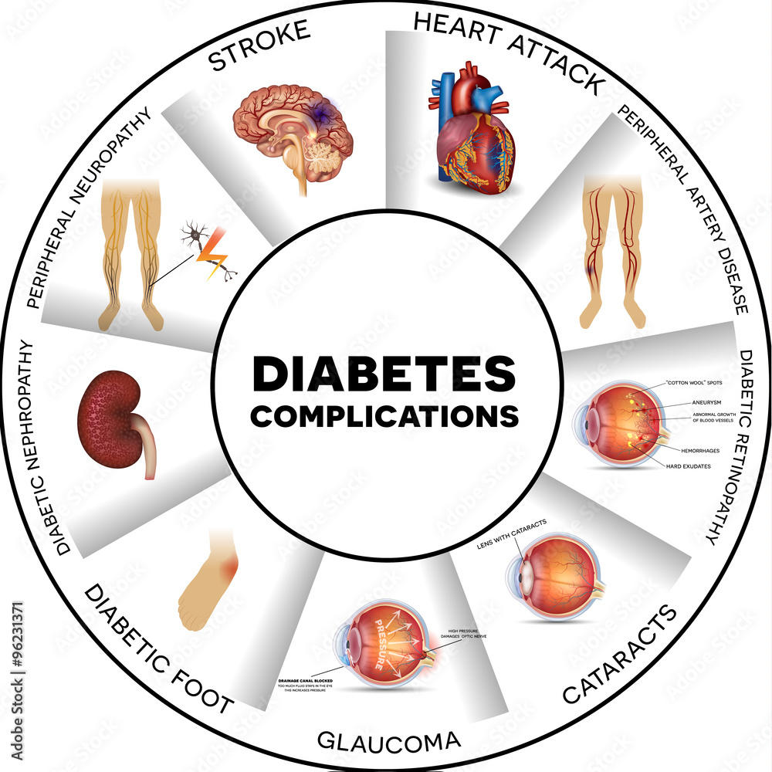

DECODING DIABETES
TAILORED PREDICTIVE MODELING FOR PIMA INDIANS
DATA 621 Fall 2023
Jaya Veluri, Khyati Naik, Mahmud Hasan, Tage Singh

Slide 2
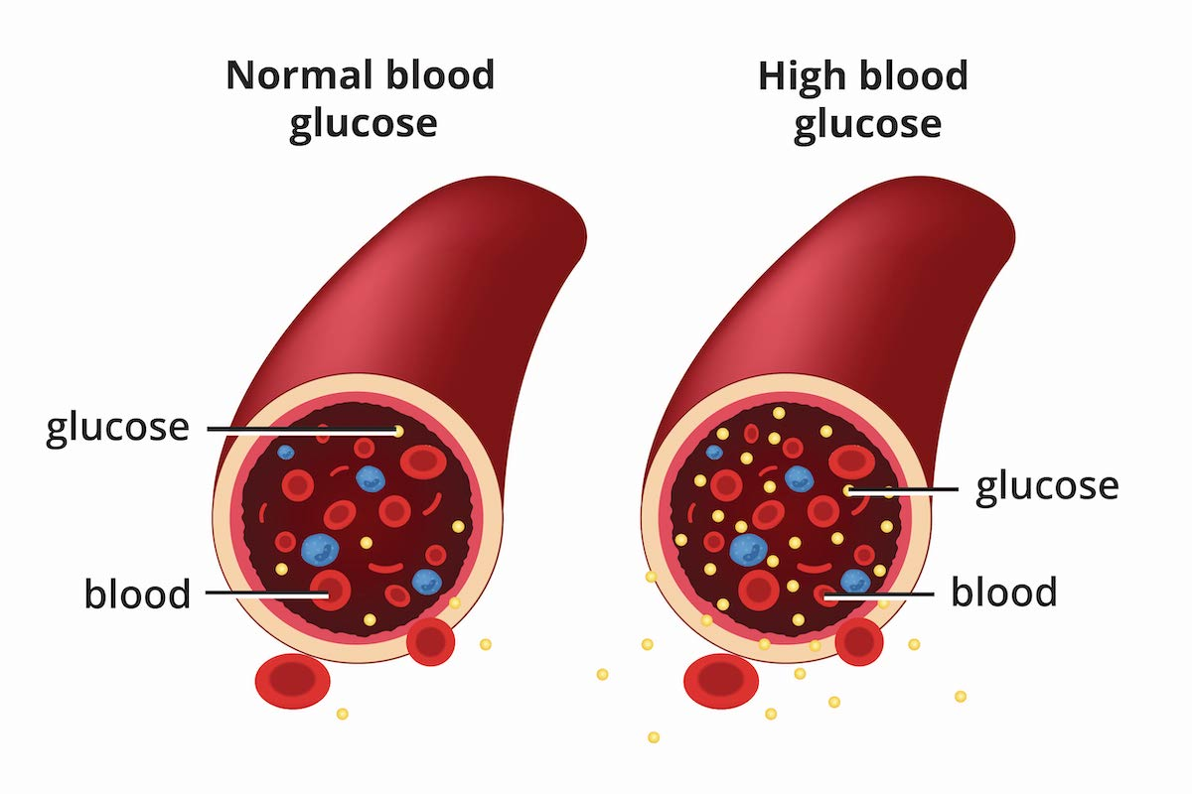
Agenda
Abstract
Introduction
Literature Review
Methodology
Modeling and Model Reviews
Conclusion
References

Slide 3
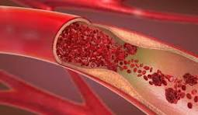
Abstract
Title: Predictive Modeling for Diabetes Diagnosis: An In-Depth Analysis
Authors: Jaya Veluri, Khyati Naik, Mahmud Hasan Al Raji, Tage Singh
Objective:- The primary goal of this project is to develop accurate predictive models for diabetes diagnosis using a comprehensive dataset. The project integrates Exploratory Data Analysis (EDA), data preprocessing techniques, and multiple machine learning models to achieve robust predictions.
The dataset, sourced from a diabetes study, is subjected to thorough exploration through summary statistics, histograms, box plots, correlation matrices, and scatter plots. These EDA techniques provide a nuanced understanding of variable distributions, relationships, and potential patterns related to diabetes.
Five distinct models are employed for predictive modeling: Logistic Regression, Random Forest, Support Vector Machines (SVM), Decision Trees, and a second Logistic Regression model with optimized feature

Slide 4

Introduction
Diabetes
The disease develops when the body does not produce enough insulin or use it appropriately, leading to high levels of sugar in the blood. Scientists first used insulin to treat diabetes in the 1920’s.
Total: 38.4 million people have diabetes (11.6% of the US population)
Diagnosed: 29.7 million people, including 29.4 million adults
Undiagnosed: 8.7 million people (22.8% of adults are undiagnosed)
Prediabetes
Total: 97.6 million people aged 18 years or older have prediabetes (38.0% of the adult US population)
65 years or older: 27.2 million people aged 65 years or older (48.8%) have prediabetes

Slide 5
About This Study and the PIMA Indians
The Pima Indians of Arizona and Mexico have contributed to numerous scientific gains through their willingness to participate in the research process.
Their involvement has led to significant findings with regard to the epidemiology, physiology, clinical assessment, and genetics of both type 2 diabetes and obesity.
Longitudinal investigations, starting in 1965, have involved study participants living on the Gila River Reservation outside Phoenix, Arizona and, since 1991, the residents of the community of Maycoba, Mexico
At the turn of the nineteenth century, one case of diabetes on the Gila River Reservation . In 1937, twenty-one persons with diabetes were recorded and it was concluded that the presence of diabetes among the Pimas was similar to that of the general U.S. population.
By the 1950's, however, the prevalence had increased ten-fold, and a study initiated in 1965 documented in the Arizona Pima Indians the highest prevalence of diabetes ever recorded.

Slide 6
Pima Indian Diabetes Prevalence: Recognized for high diabetes rates, the Pima Indian population poses a unique health challenge.
Need for Specialized Models: Elevated prevalence underscores the need for tailored predictive models for accurate diabetes prediction.
Distinctive Health Profile: The Pima Indian community's distinct health profile necessitates targeted efforts in understanding and predicting diabetes.
Motivation for Predictive Models: Effective models enable early detection, timely interventions, resource optimization, and deeper insights into diabetes factors.
Central Research Question: Can a meticulously crafted predictive model reliably classify Pima Indian female patients based on diverse medical features for precise diabetes predictions?

Slide 7
Literature Review
There have been several successful methodologies, such as Zolfaghari's ensemble of SVM and BP NN achieving 88.04% accuracy and Naz and Ahuja's deep learning approach reaching an impressive 98.07% accuracy on the PIMA dataset.
Notably, Zhou, Xin, and Li showcase a model based on Boruta feature selection and ensemble learning with a remarkable 98% accuracy, while Rahman, Abdulrazak, et al.'s socio-demographic-based approach attains an outstanding accuracy of 99.36% using random forest.
Additionally, Saxena, Sharma, and Gupta's comparative study explores classifiers and feature selection techniques, achieving a commendable 79.8% accuracy with a random forest classifier on the PIMA Indians diabetes dataset.
The study by Zhou, Xin, and Li introduces a unique diabetes prediction model based on Boruta feature selection and ensemble learning, demonstrating an impressive 98% accuracy on the PIMA Indian diabetes dataset.
A study by Rahman, Ali, et al. addresses the issue of diabetes prediction in lower-income countries, proposing an ML model based on socio-demographic characteristics. Their model, utilizing random forest, achieved an outstanding accuracy of 99.36%, emphasizing the potential of non-clinical attributes for accurate diabetes prediction.
These research activities establishes a robust foundation for our research, offering insights into successful methodologies, their accuracies, and potential areas for improvement in predicting diabetes within this specific population.

Slide 8
Methodology
1 | Dataset Details
The Dataset consists of 9 Predictor Variables and 1 Outcome Variable
Variable | Data Type | Description
Pregnancies | Numeric | To express the number of pregnancies
Glucose | Numeric | To express the glucose level in blood
BloodPressure | Numeric | To express the blood pressure measurement
SkinThickness | Numeric | To express the thickness of the skin
Insulin | Numeric | To express the insulin level in blood
BMI | Numeric | To express the body mass index
DiabetesPedigreeFunction | Numeric | To express the likelihood of diabetes based on family history
Age | Numeric | To express age
Outcome | Categorical | Categorical To express the whether someone has diabetes. 1 is Yes and 0 is No
https://raw.githubusercontent.com/Naik-Khyati/data_621/main/final_project/

Slide 9
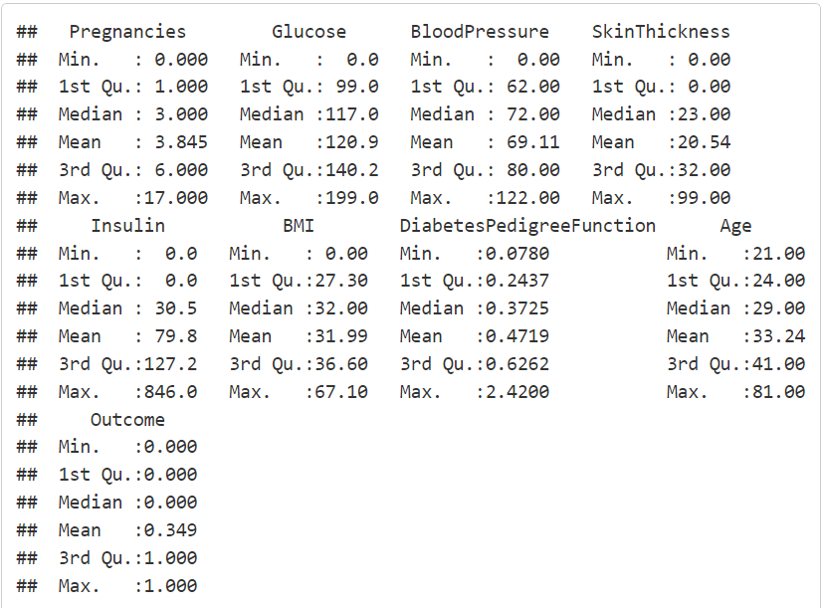
Methodology
2-1 | Data Preparation
Summary Statistics
The summary statistics reveal a wide range of values for each variable. Notably, variables such as glucose, BMI, Insulin, and age exhibit considerable variability, which is crucial for understanding the dataset’s diversity.

Slide 10
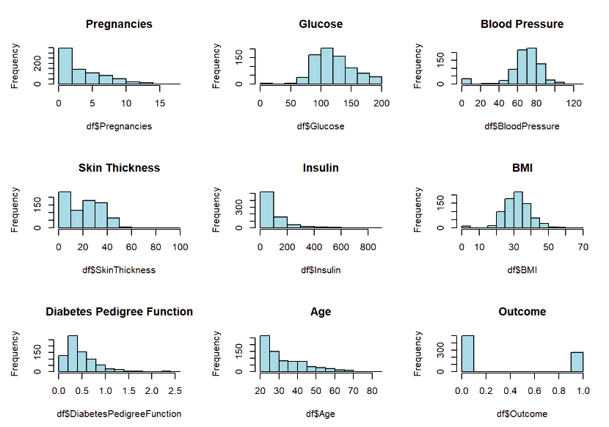
Methodology
2-2 | Data Preparation
Histograms of Dataset Variables
The histograms shows the distribution patterns of each variable. For instance, pregnancies exhibit a right-skewed distribution, indicating a higher frequency of individuals with fewer pregnancies. Similarly, variables Skin Thickness, Insulin, Diabetes Pedigree Function and Age are also right skewed. This information is valuable for assessing the prevalence of specific conditions.

Slide 11
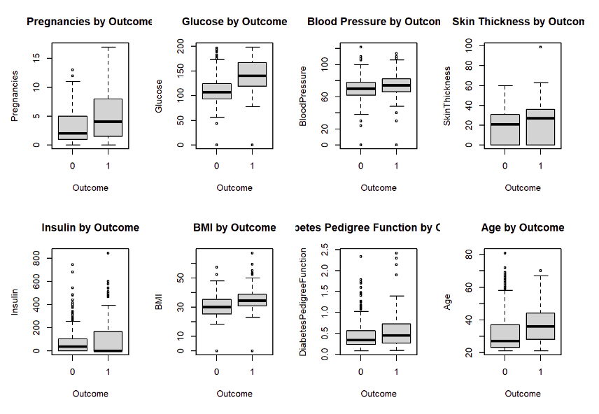
Methodology
2-3 | Data Preparation
Box Plots of Dataset Variables
Box plots highlight potential differences in variable distributions based on diabetes status. Notably, the box plot for glucose, pregnancies and age suggests higher median values for individuals with diabetes, indicating a potential feature for predictive modeling.

Slide 12
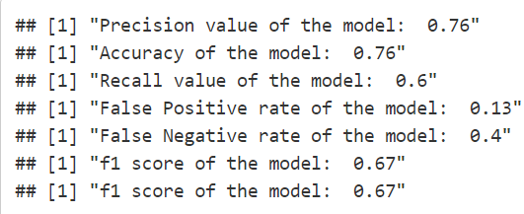
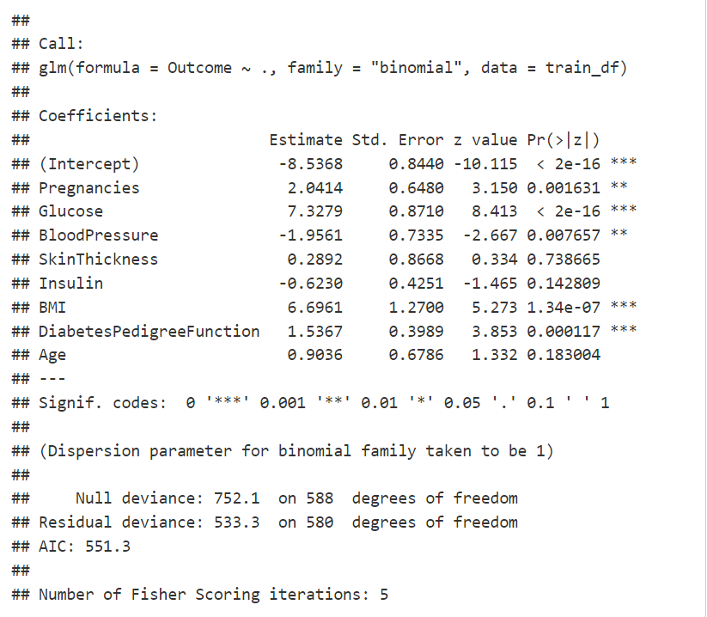
Modeling – Model 1
Logistic Regression with All features
Model 1(logistic regression model) exhibits a decent overall accuracy of 0.76, indicating that about 76% of predictions are correct. Precision stands at 0.76, reflecting the accuracy of positive predictions is 76%. However, the recall (sensitivity) is at 60%, suggesting the model may miss capturing some positive cases. On the other hand, specificity is high at 87%, indicating a strong ability to correctly identify negative cases. The false positive rate of the model is 0.13, indicating that 13% of negative predictions were incorrect, while the false negative rate is 0.40, indicating that 40% of actual positive cases were missed. The F1 score is 0.67, suggesting that the model has found a satisfactory equilibrium between making accurate positive predictions and capturing a significant portion of actual positive cases. The model1 has favorable accuracy and precision, but it has a lower sensitivity and notable false negative rate.

Slide 13
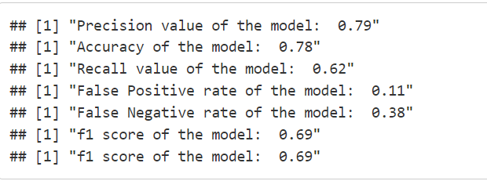
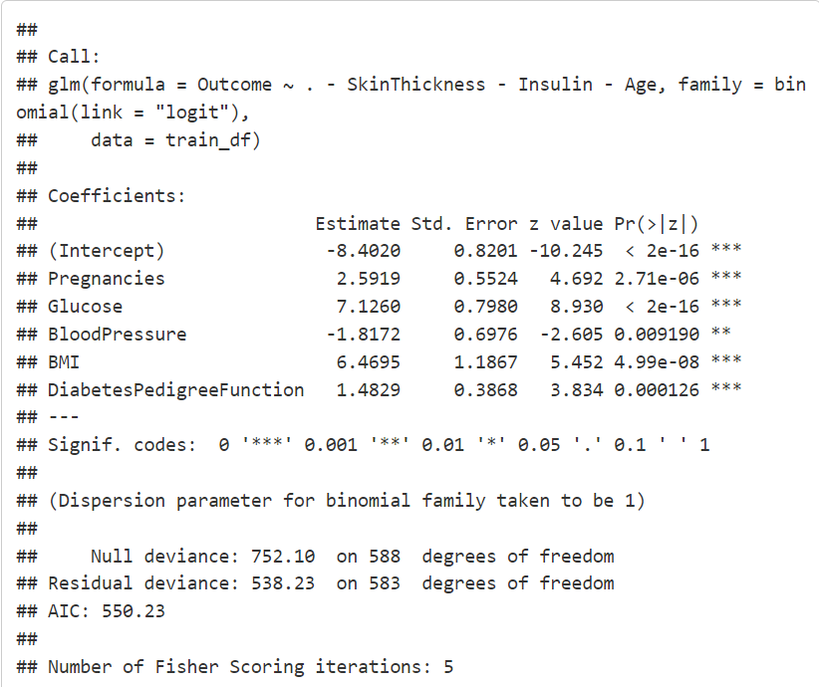
Modeling – Model 2
Logistic Regression with significant features
Model 2(logistic regression model) exhibits a good overall accuracy precision of 0.78,indicating that about 78% of predictions are correct. Precision stands at 0.79,indicating that it is correct of predicting a positive outcome about 79% of the time. A recall of 0.62 indicates that it captures 62% of the actual positive cases. Importantly, the model maintains a low false positive rate (11%) and false negative rate (38%), minimizing both types of errors. The F1 score, a balance of precision and recall, is at 0.69, indicating the model’s balanced ability to make accurate predictions while avoiding excessive false positives or negatives.

Slide 14
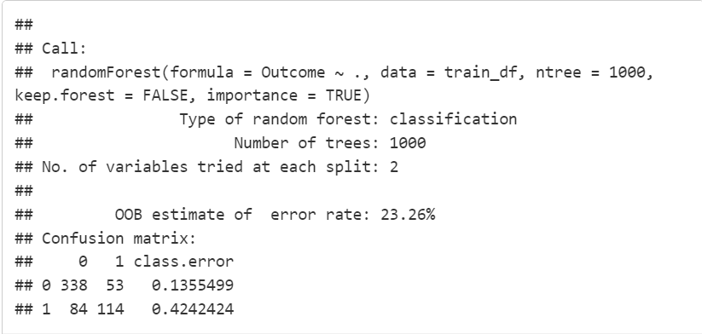
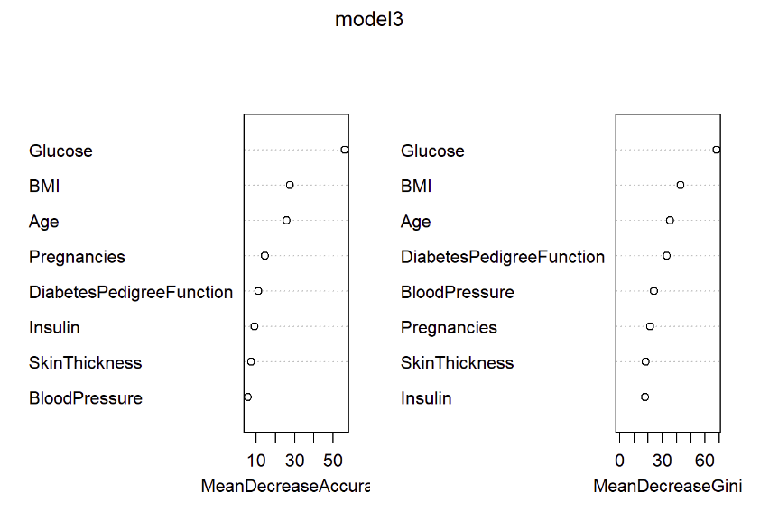
Modeling – Model 3
Random Forest
Model 3(random forest model) shows an out-of-bag (OOB) estimate of the error rate, which is approximately 23.26%. The confusion matrix indicates the model’s performance on the training data, with the class error rates for each class (0 ad 1). For class 0, there are 338 correct predictions and 53 miss classifications, resulting in a class error rate of 13.55%. For class 1, there are 118 correct predictions, 80 miss classifications, and a class error rate of 40.40%. In a classification context, lower error rates are indicative of better accuracy. In healthcare applications, where accurate predictions are crucial for patient well-being a 23.26% out-of-bag (OOB) error rate is considered to be relatively high. Therefore, the random forest model demonstrates a moderately well performing model in classifying the data.

Slide 15
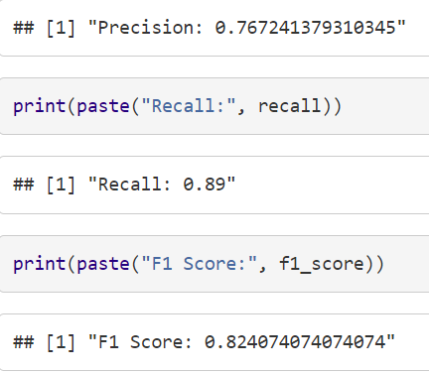
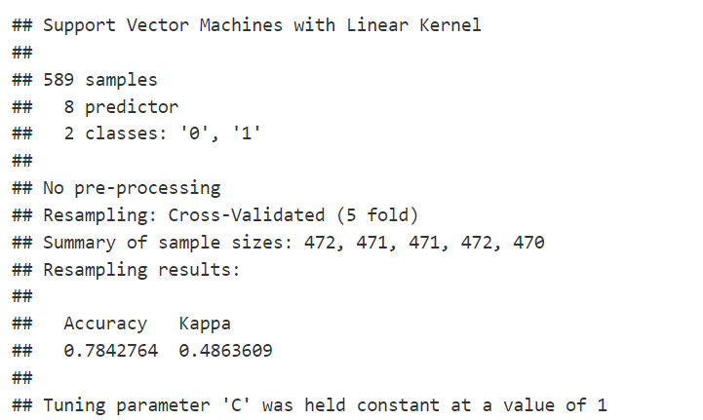
Modeling – Model 4
Support Vector Machines
Model 4 i.e. the Support Vector Machines (SVM) model with a Linear Kernel achieved an accuracy of approximately 78.43% during cross-validated re-sampling, indicating that around 78.43% of predictions were correct. The model’s precision stands at 0.767,indicating that it is correct of predicting a positive outcome about 76.70% of the time. A recall of 0.89 indicates that it captures 89% of the actual positive cases. The F1 score is at 0.824,indicating the model’s maintaining a good a balance of precision and recall. The model demonstrates a reasonably good model in predicting classification

Slide 16
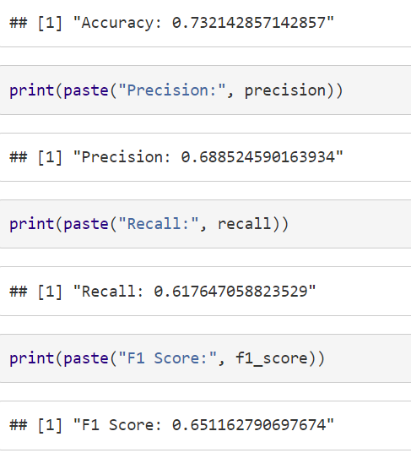
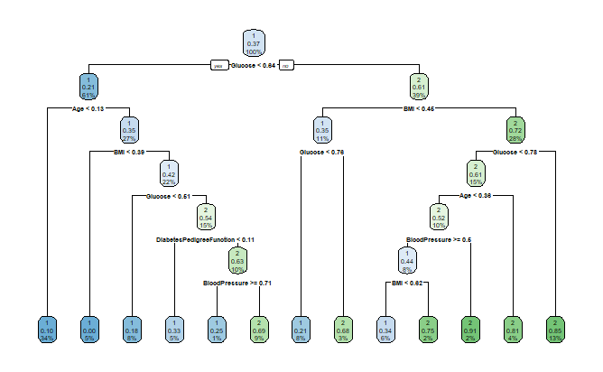
Modeling – Model 5
Decision Tree
Model 5, the Decision Tree model, exhibits moderate performance with an accuracy of 73.21%, indicating that approximately 73.21% of predictions are correct. The model’s precision stands at 68.85%,indicating that the model predicts a positive outcome correctly about 68.85% of the time. The recall (or sensitivity) is at 61.76%, suggesting that the model captures about 61.76% of actual positive cases. The F1 Score,65.12% is indicating a reasonable trade-off between the two metrics, precision and recall. This model reflects a moderately accurate performing model.

Slide 17
Model Performances Comparison & Selection - 1
Comparison between two logistic regression models, Model 1 & Model 2
Model 2 exhibits better performance metrics compared to Model 1
Model 2 has a higher precision (0.79), accuracy (0.78), recall (0.62), and F1 score (0.69) than Model1, indicating a better overall balance between true positive and false positive rates. Additionally, Model 2 has a lower false positive rate (0.11) and false negative rate (0.38) than Model 1, contributing to its enhanced predictive capabilities
Moreover, the AIC value, a measure of model goodness of fit and complexity, favors Model 2 (AIC = 550.23) over Model 1 (AIC = 551.3), signifying improved overall performance and model simplicity

Slide 18
Model Performances Comparison & Selection - 2
Comparison – Model 2, Model 3, Model 5:
Model 3 (random forest tree model) has 23.26% out-of-bag (OOB) error rate, which is considered to be relatively high in the context of accurately classifying positive outcome in health care applications. Therefore, this is not preferable model choice
On the other hand, Model 2 (logistic regression model) outperforms model5 (decision tree model) in considering model accuracy, precision, recall, and F1 score. Hence, Model 2 is preferable choice to use

Slide 19
Model Performances Comparison & Selection - 3
Comparison between Model 2 and Model 4
Model 2 (logistic regression model) demonstrates superior performance over Model4 (support vector machine model).
Despite Model 4 has achieved an accuracy of approximately 78.43% and a precision of 0.767, Model2 outperforms with a higher precision of 0.79, reflecting its higher ability to correctly predict positive outcomes around 79% of the time

Slide 20

Conclusion
Model Choice – Model 2
Exhibits a balanced accuracy of 78% - Similarity to Model 4’s accuracy
Maintains lower false positive and false negative rates at 11% and 38% respectively - Minimizing errors in either direction.
Lower AIC value of 550.23 - Demonstrates simplicity - Highlights the significance of predictors in influencing outcomes.
We conclude that - “YES” - A meticulously crafted predictive model (Model 2) can reliably classify female patients of Pima Indian heritage based on diverse medical features, facilitating precise predictions of diabetes status.

Slide 21
References -
https://www.ncbi.nlm.nih.gov/pmc/articles/PMC4418458/
https://www.cdc.gov/diabetes/data/statistics-report/
https://www.mayoclinic.org/diseases-conditions/diabetes/symptoms-causes/syc-20371444
https://www.niddk.nih.gov/health-information/diabetes/overview/what-is-diabetes
https://pixabay.com/images/search/diabetes/
https://pixabay.com/images/search/diabetes/

